Slide 1

PRODUCT MANAGEMENT CASE STUDY
District by Zomato
Strategic expansion into the unified "going-out" and entertainment ecosystem.

Slide 2

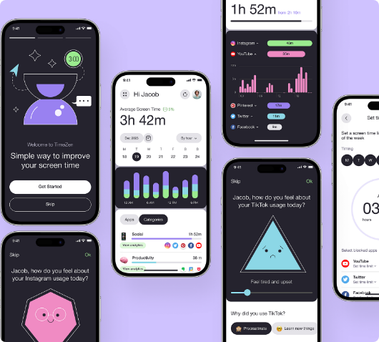
01. Strategic Context
Leveraging Core Strengths
Zomato has established absolute dominance in the food-tech sector with 50M+ Monthly Active Users.
Strategic Rationale
•
Ownership of the entire social loop
The core business model revolves around high-frequency utility, providing the perfect data foundation to expand into adjacent lifestyle categories.
•
Increased Average Revenue Per User (ARPU)
•
Defense against specialized experience apps
•
Logistical & Payment infrastructure reuse
The Opportunity: The multi-billion dollar offline "going-out" market is currently fragmented and ripe for digital consolidation.
ZOMATO STRATEGIC ANALYSIS
SLIDE 01

Slide 3
02. Background
What is District?
The Problem Space
Launched in November 2024, District is Zomato's dedicated mobile application for discovering and booking "going-out" experiences.
Users face constant friction when answering the question: "What should we do today?"
The platform aggregates movies, live events, dining, sports, and cultural activities into a single, unified interface.
District targets this discovery gap by providing a hyper-local, curated ecosystem that moves beyond simple transactional booking to lifestyle inspiration.
PRODUCT OVERVIEW
SLIDE 02

Slide 4



03. Challenges
Discovery Awareness
Infrequent Category
Low baseline awareness of niche local events. Users historically relied on word-of-mouth or social media.
Unlike daily food ordering, entertainment is a weekly or monthly activity, making habit formation difficult.
Fragmented Platforms
Retention Hurdles
Disjointed user journeys across multiple apps for movies, comedy, and concerts created friction.
Preventing churn after a single high-profile event booking (e.g., a major concert) is a critical PM focus.
MARKET & PRODUCT FRICTIONS
SLIDE 03

Slide 5

04. The Approach
Ecosystem Leverage: Tapped into Zomato’s 50M+ user base for instant distribution.
Discovery-First UI: Focused on AI-driven recommendations rather than just search.
Inorganic Growth: Accelerated speed-to-market via Paytm ticketing acquisition.
Operational Efficiency: Simplified booking flow and stepwise expansion (Metro → Tier 2).
Product Philosophy
"Moving the user from 'I'm hungry' to 'I want an experience' within the same trusted brand ecosystem."
STRATEGIC EXECUTION
SLIDE 04

Slide 6
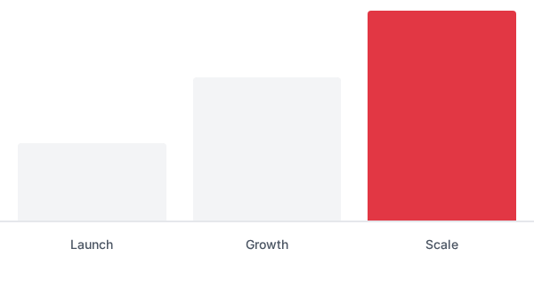
05. Outcomes
45%
2.4x
EVENT VISIBILITY INCREASE
ENGAGEMENT MULTIPLIER
Market Visibility
By consolidating TicketNew and Insider under the District brand, Zomato significantly increased event visibility and created a new revenue stream beyond food logistics.
Stronger Lifestyle Positioning
District has successfully transitioned Zomato from a transactional delivery app into a broader lifestyle destination, significantly increasing Lifetime Value (LTV).
IMPACT & RESULTS
SLIDE 05

Slide 7
06. Product Management Lessons
Leverage Distribution: Using an existing, trusted ecosystem is 10x more effective than building a user base from scratch.
Discovery > Search: In lifestyle categories, users don't always know what they want. Inspiration beats navigation.
Validate before Scaling: Deep PMF in Metro hubs must be established before aggressive Tier-2 expansion.
Consolidation Accelerates: In fragmented markets, strategic acquisition (Paytm) is the fastest way to acquire domain expertise.
KEY TAKEAWAYS
SLIDE 06

Slide 8
DISCUSSION
Thank You

